Slide 1
To Renovate or Not to Renovate
BY: Carlos Marin

Slide 2
Outline
Background
Business Problem
Data
Methods
Results
Conclusions

Slide 3

Background
Every Year, Americans renovate their home so when it comes time to sell, they can get best return. I create two multiple linear regression models based on whether they were renovated or not.

Slide 4
Business Problem
How much does renovating or not renovating your home affect pricing of the home? By creating a multiple linear regression models we can see how each coefficient works with pricing. From this we can create an actual formula that can be used to calculate how much your home will sell for, once renovated or not renovated

Slide 5
Data
Using King County data set. The data set is separated by renovated and non-renovated and then normalization data processing is done.
Renovated data set has 744 rows
Non renovated data set has 3842 rows.
Both have 5 columns

Slide 6
Methods
First separate data a sets by whether they were renovated or not.
Data Processing
Perform Multiple Linear Regression identify formula
Data trimmed to remove unnecessary outliers.
Post-trimming Update formula.

Slide 7
Results
Pre-Trimming Multiple Linear Regression –Renovated and Non data set
Effect on Price | Area Renovated
-105,896 | Bedrooms
14,605 | Bathrooms
549, 565 | Square footage of living area
-112,215 | Square footage apart from basement
Effect on Price | Areas Not- Renovated
-53,475 | Bedrooms
5,390 | Bathrooms
276,346 | Square footage of living area
-31,960 | Square footage apart from basement
After running the Multiple linear regression model, first thing we notice is that bedrooms and square footage apart from basement have a negative correlation on price, after renovations We can see apart of number of bedrooms, and square foot above, there is a greater impact on price when it comes to bathrooms and square foot of living area. The negative values in bedrooms and squarefoot above area indicates as price increases, they share negative correlation (”as one goes up the other goes down”).

Slide 8
Results
BUT WAIT THERE IS MORE!
Post model evaluation, we see that some coefficients are not really relevant. The most possible cause is due to outliers (or abnormal values).
One fix is the removal of outliers. Well, how many outliers are there in the data set? Well let’s look…

Slide 9
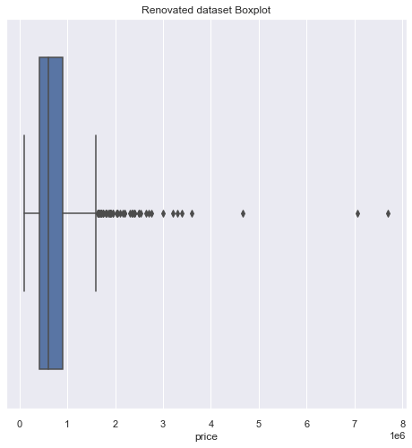
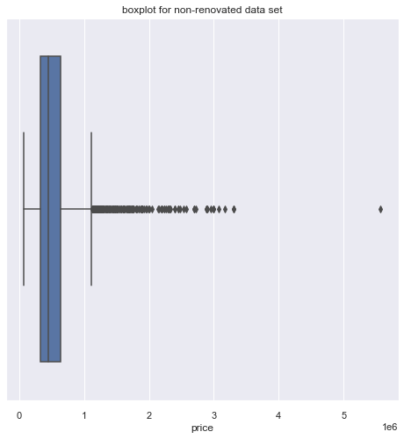
Results
Visualization of Outliers in Renovated and non-Renovated
To see outliers use what’s known as boxplots, where everything outside of the lines and boxes, are considered outliers. They affect our model because they are considered abnormal values.

Slide 10
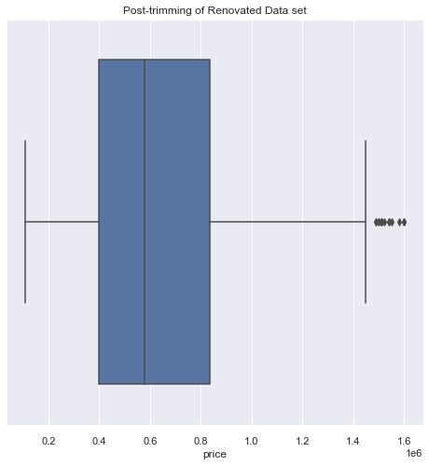
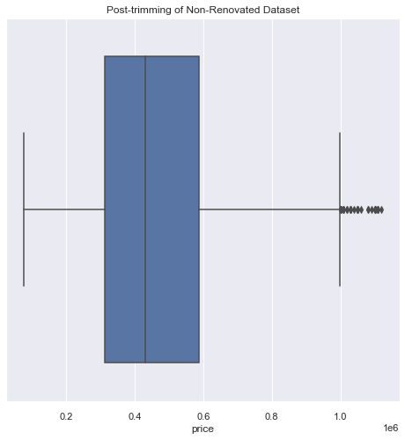
Results
Visualization of Outliers POST-TRIMMING in Renovated and non-Renovated
This is what post-removal of outliers looks like.

Slide 11
Results
Post-Trimming Multiple Linear Regression –Renovated and Non data set
Effect on Price | Area Renovated
-56,480 | Bedrooms
99,200 | Bathrooms
281,300 | Square footage of living area
-47,790 | Square footage apart from basement
Effect on Price | Areas Not- Renovated
-29,340 | Bedrooms
11,030 | Bathrooms
181,400 | Square footage of living area
-16,270 | Square footage apart from basement
Post Trimming the new shape for the renovated data set is 644 rows (down from 744), 5 columns.
Post trimming new shape for non-renovated data set is 3648 rows (down from 3842), 5 columns

Slide 12
Conclusions/ Findings
After modeling the multiple linear regression model. We see both negative coefficients (areas renovated and areas not renovated). While both do share negative coefficients with bedrooms and square footage apart from basement. In the renovated data set, the positive coefficients (bathrooms and square footage of living area), quickly negate the negative affects and greatly impact price in comparison on non-renovated houses.

Slide 13
Next Steps…
1) Evaluate renovated homes by decade renovated
2) Evaluate homes based on what year they were built (by decade built) and comparing whether renovation is necessary.
3) Evaluate what other areas of home can greatly impact price for renovated and non-renovated homes (e.g., kitchen, garage, etc.)

Slide 14

Thank you!

